Slide 1
Layers of Abstraction in Computer System
Jiaming Xu
2023.9.20

Slide 2
Computer Architecture Definition
Bridge application and technology
Application
Gap too large to bridge in one step
➔ Computer Architecture: develop abstraction and implementation layers to execute information processing application efficiently using available fabrication technology
Technology
Slides from Jie Zhang, Computer Architecture

Slide 3
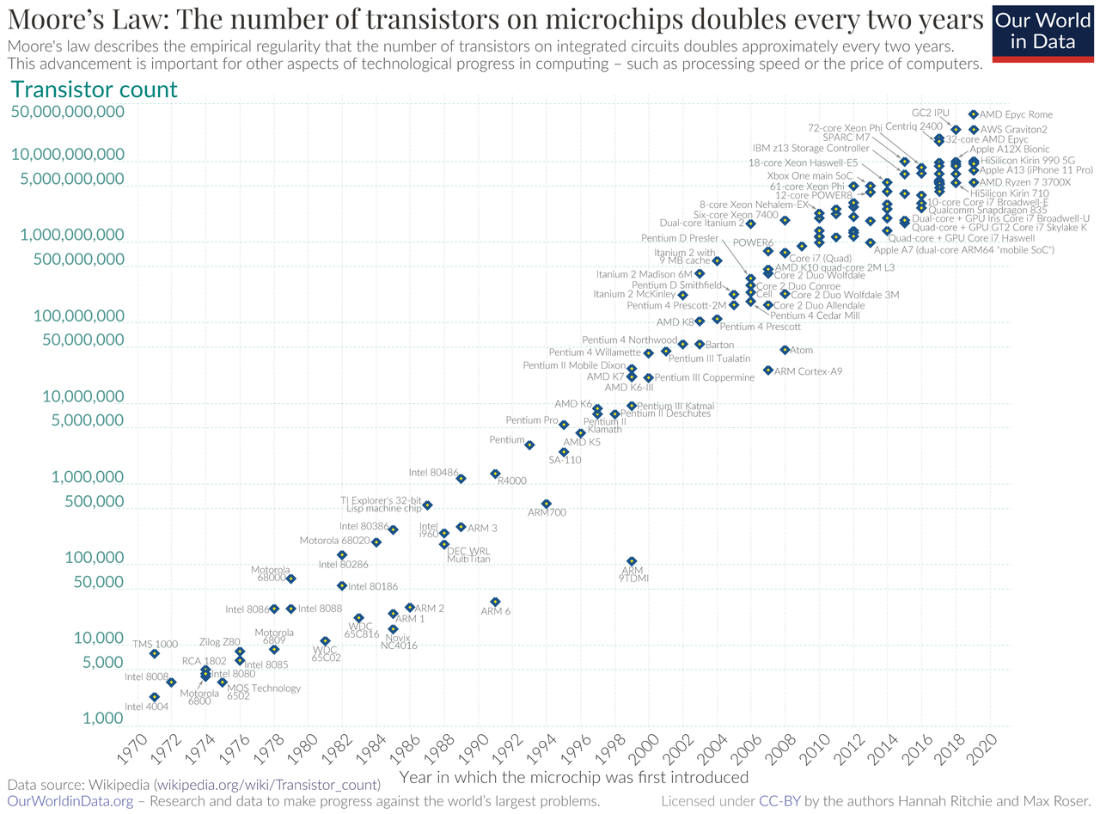
Why Abstraction
Better develop
The Moore’s law
Years of development
More layers, the quicker

Slide 4
Why Abstraction
Better use
abstracts out low-level implementation details
Good or not?
What is the bottleneck of today’s software?
Memory? No
Bandwidth? May not
…
Energy inefficiency
3GW for Google’s data center
800MW for Meta’s data center

Slide 5

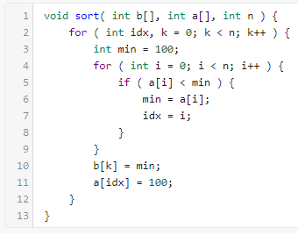
Computer System Stack
Ex) Sort an array of numbers
2,6,3,8,4,5 → 2,3,4,5,6,8
Application
Algorithm
Algorithm
Out-of-place selection sort algorithm
Find min number in array
Move min number into output array
Repeat steps 1 & 2 until finished
Programming Language
Programming Language
Operating Systems
Operating Systems
Operating Systems
Instruction Set Architecture
Instruction Set Architecture
Instruction Set Architecture
C implementation of selection sort
Microarchitecture
Microarchitecture
Computer Architecture
Microarchitecture
Register-Transfer Level
Register-Transfer Level
Register-Transfer Level
Gate Level
Gate Level
Gate Level
Circuits
Circuits
Devices
Devices
Technology
Technology
Slides from Jie Zhang, Computer Architecture

Slide 6
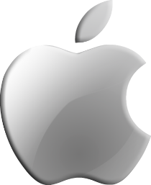


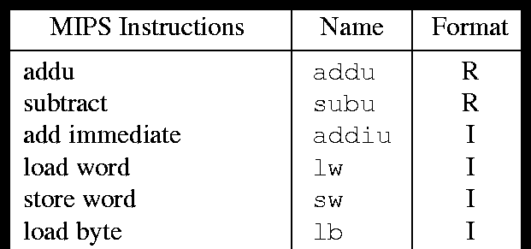
Computer System Stack
Application
Mac OS X, Windows, Linux
Handles low-level HW management
Algorithm
Programming Language
Operating Systems
Operating Systems
Instruction Set Architecture
Instruction Set Architecture
Microarchitecture
MIPS32 Instruction Set
Instructions that machine executes
Computer Architecture
Register-Transfer Level
Gate Level
Circuits
Devices
Technology
Slides from Jie Zhang, Computer Architecture

Slide 7
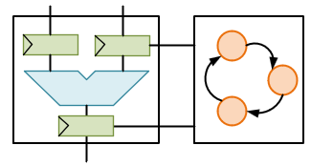
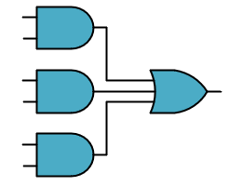
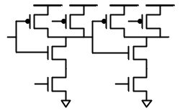
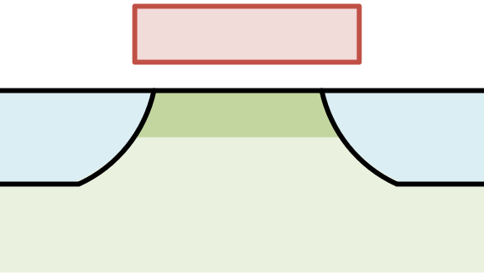
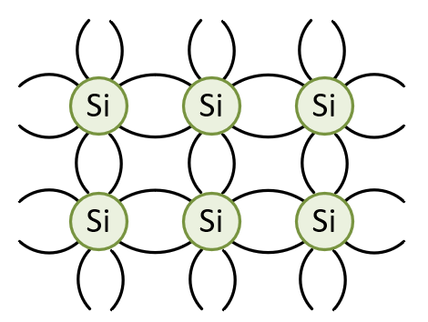
Computer System Stack
Application
How data flows through system
Algorithm
Programming Language
Boolean logic gates and functions
Operating Systems
Instruction Set Architecture
Combining devices to do useful work
Computer Architecture
Microarchitecture
Register-Transfer Level
Gate Level
Gate Level
Gate Level
Transistors and wires
Circuits
Circuits
Devices
Devices
Silicon process technology
Technology
Technology
Slides from Jie Zhang, Computer Architecture

Slide 8
Logic, State, and Interconnect
Application
Digital systems are implemented with three basic building blocks
Logic to process data
State to store data
Interconnect to move data
Algorithm
Programming Language
Operating Systems
Instruction Set Architecture
Computer Architecture
Microarchitecture
Logic
State
Logic
State
Logic
Register-Transfer Level
Gate Level
Interconnect
Circuits
State
Logic
State
Logic
State
Devices
Technology
Slides from Jie Zhang, Computer Architecture

Slide 9
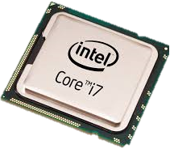
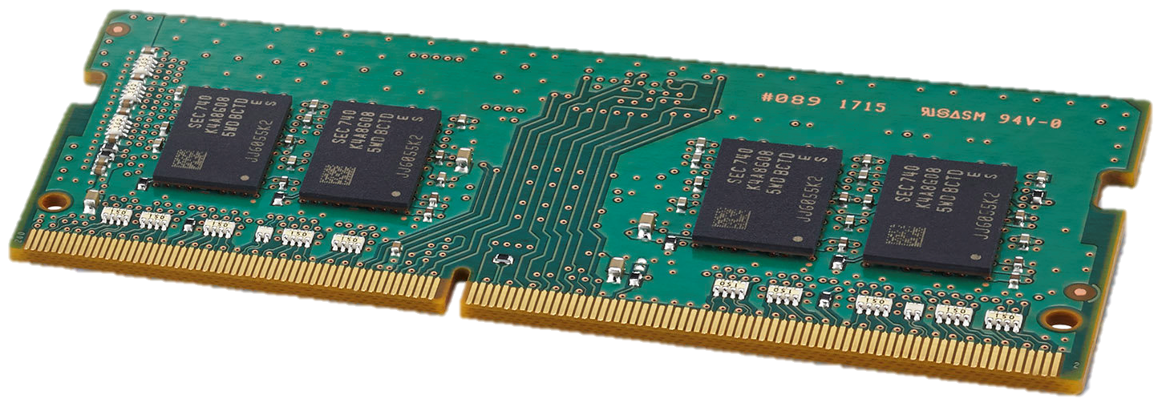
General-Purpose Computing:
Application
Computer engineering basic build blocks
Processors for computation
Memories for storage
Networks for communication
Algorithm
Programming Language
Operating Systems
Instruction Set Architecture
Computer Architecture
Microarchitecture
Register-Transfer Level
Gate Level
Input data
Network
Output data
Circuits
Devices
Technology
Slides from Jie Zhang, Computer Architecture

Slide 10
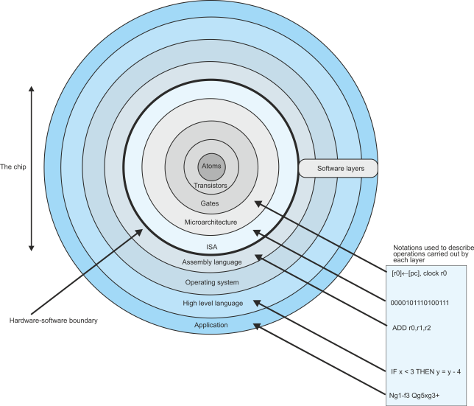
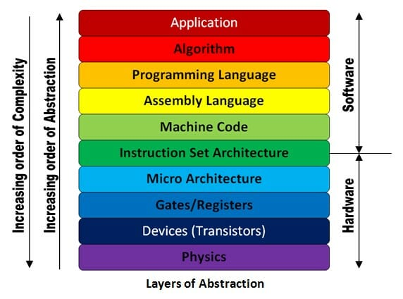
Other Version of Abstractions

Slide 11
Development of CODE
Electrical signal (on/off)
Machine code (0/1)
Assembly language
Some notations help to
communicate with machine
High-level language
More abstractive
More human-mindset

Slide 12
Examples of CODE
C/C++ (.c/.cpp, .h/.hpp)
Java
GCC
↓Compiler
Assembly language (.s)
↓Assembler
Machine Code (.o, .so, .a)
↓Linker
CLANG (LLVM)
↓Compiler
LLVM IR
↓LLVM Optimizer
LLVM Backend
↓Assembler
↓Linker
JVM
↓Compiler
Java Bytecode
(Java Virtual Machine)
↓Assembler
↓Linker
Machine Code
JIT
↓Compiler
Java Bytecode
↓Just In Time compiler
Machine code
(Java Virtual Machine)
↓Linker
Machine Code

Slide 13
Thanks & Advertisement

Slide 14
Who Am I?
Jie Zhang
Ph.D. advisor, Boya Young Scholar, NSFC Excellent Overseas Young Scientists Fund
Assistant Professor, Peking University
KAIST, South Korea, Postdoctoral Researcher in Computer Science
Yonsei University, South Korea, Ph.D. in Computer Science
Web: https://jiezhang-camel.github.io/

Slide 15











CHASE Lab
Research:
Computer architecture
Storage and memory systems
Members:
Shushu Yi (Ph.D., graduated from Nanjing University)
Xiurui Pan (intern @ Tsinghua University)
Li Peng (intern @ HUST)
Yuda An, Zeyu Li (interns @ Peking University)
Research collaborators
Notes:
五道口理工学院、武汉某和尚院校

Slide 16
We are hiring
If you are interested in CA, storage or research,
please send your information to
jiez@pku.edu.cn

Slide 17
Reference
Computer Organization And Design: The Hardware/Software Interface (David a. Patterson, John L. Hennessy) Chapter 1, 2
Moore's law – Wikipedia
Computer Hierarchy (alanclements.org)
Understanding the Layers of a Computer System - Secplicity - Security Simplified

